Slide 1
CrowdTrust
Giovanni Charles, Adam Fiksen, Ryan Jackson, Sahil Jain, John Walker
Supervisor: Emil Lupu

Slide 2
I have a collection of 100 photos of birds, and know which ones are robins. I don’t know anything about birds?
“How can I get an accurate result set?”

Slide 3
Crowdsourcing
What is it?
Why is it needed?
Who uses it?

Slide 4
What’s out there
Main competitors:
Amazon’s Mechanical Turk
Microworkers
StackOverflow/Wikipedia

Slide 5
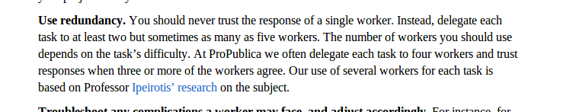

Slide 6
Proposed Solution
General purpose online crowdsourcing platform
Analyses the crowd
Gives accurate results

Slide 7
Demo

Slide 8
What do we do with all this data?
Get the right answer
Find out who is good

Slide 9
What’s the right answer?
Based on
Prior knowledge
Annotator accuracies

Slide 10
Calculating the accuracies
Based on
What we know about you
New evidence
How do we combine it?

Slide 11
The EM Algorithm
E-Step
Calculate the expected true response
M-Step
Infer the most likely accuracy

Slide 12
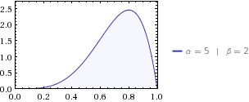
First attempt
Based on
What we know about you

Slide 13
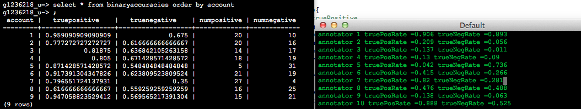
First attempt

Slide 14
Second attempt
Based on
What we know about you
Trouble makers considered
New evidence
Combined with a numerical method

Slide 15
Third attempt
Based on
What we know about you
Trouble makers considered
New evidence
Convex conjugate

Slide 16
Adaptations
Experts/Bots
Convex conjugate
N Continuous

Slide 17
Software Engineering Practices
Pair Programming
Testing each other’s code
Informative workspace
Stand up meetings
Database Token

Slide 18



Collaboration Tools

Slide 19
Enhancements
Hybrid computing
Dynamic pricing model
Mobile app

Slide 20
Conclusions
Successfully developed a generic framework
Generalised EM algorithm to obtain optimum number of people to ask.
Produced an easy to use website which allowed people to complete tasks

Slide 21
Thank you for listening! Questions?

